Slide 1
On the Compensating Effects in the Evaluated Cross Sections of ²³⁵U
A. Trkov, R. Capote
International Atomic Energy Agency
Vienna, Austria

Slide 2
Evaluation Strategy
“Best physics” not to be compromised by benchmark results
Adjustments limited to uncertain quantities
Recent work shows that PFNS should be softer for all actinides at all incident energies, resulting in strong impact on reactivity
Compensating effects must be found to restore performance of the evaluated data
From different reactions of the same material
From other materials in the benchmark config.

Slide 3
U-235 Example - Scope
Considered for CIELO Starter File in this work:
PFNS for incident thermal neutrons is softer, evaluated with GMA for “Standards”.
PFNS for fast neutrons (0.5 MeV – 2 MeV) evaluated with GANDR (possibly too soft)
PFNS evaluation by Talou for the CRP on PFNS
Resonance parameters from ORNL Ver.4

Slide 4
U-235 Example – Scope (Cont.)
New evaluation with EMPIRE above the resonance range
Dispersive CC optical model fitted to all "optical scattering" data (total- quasielastic angular distributions, strength functions, etc)
Fission channel was fitted to reproduce Neutron Standards fission
The above constrain capture and elastic/inelastic

Slide 5
Benchmarking of Fast Systems
Bess et al.: “What if Lady Godiva was wrong?”
ND2013 paper
Use of sensitivity profiles from ICSBEP for bare assemblies:
Sensitivities to fission and capture are similar
Different sensitivities to elastic and inelastic – reconciling differences between e.g. FMF001 and HMF008 seems possible, BUT…
Direct calculations with perturbed cross sections:
Coarse-group sensitivities inadequate
Strong non-linearities
Conclusions:
Foreseen changes in elastic and inelastic do not reduce the difference
Uncertainties in ICSBEP are likely to be underestimated
ND2013 paper possibly biased by the choice of benchmarks

Slide 6
List of fast bare benchmark assemblies
1 HEU-MET-FAST-001\hmf001 Godiva
2 HEU-MET-FAST-008\hmf008 VNIIEF-CTF-bare
3 HEU-MET-FAST-018\hmf018 VNIIEF_Sphere
4 HEU-MET-FAST-051\hmf051-01 ORCEF-01
5 HEU-MET-FAST-051\hmf051-02 ORCEF-02
6 HEU-MET-FAST-051\hmf051-03 ORCEF-03
7 HEU-MET-FAST-051\hmf051-15 ORCEF-15
8 HEU-MET-FAST-051\hmf051-16 ORCEF-16
9 HEU-MET-FAST-051\hmf051-17 ORCEF-17
10 HEU-MET-FAST-100\hmf100-1 ORSphere-1
11 HEU-MET-FAST-100\hmf100-2 ORSphere-2

Slide 7
Benchmarking of Fast Systems
Testing PFNS:
“u236g6b” GMA PFNS has “no” effect
“u235g6c” GMA+Talou PFNS has “no” effect.
“u235g6a” GMA+GANDR+Talou reduces reactivity – GANDR fast PFNS probably too soft.

Slide 8
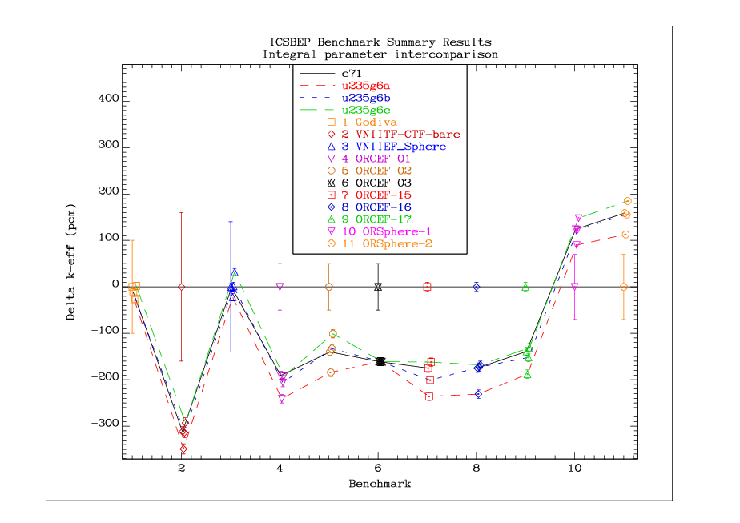

Slide 9
Benchmarking of Fast Systems
Trial evaluations:
“u235ib02o4cWg6anu”
ORNL Ver.4 resonance data
EMPIRE calculation above resonance range
PFNS GMA thermal, GANDR fast, Talou above
Adjusted capture (based on Wallner measurements)
Adjusted thermal nu-bar (decreased by 0.34%)
“u235ib02o4g6cnuf3” as above, but:
No capture adjustment
No GANDR PFNS (fast)
Nu-bar (fast) increased by 0.3%
In both cases good performance is restored for bare assemblies!
The nu-bar increase could be smaller (~0.2%)

Slide 10
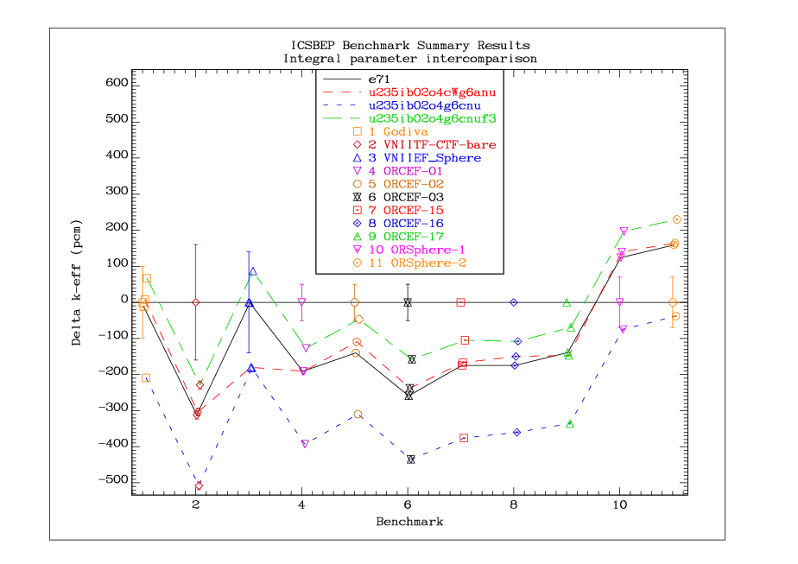

Slide 11
Other fast benchmarks
Both new evaluations are comparable in most cases → compensation is not unique
The “u235ib02o4g6cnu” evaluation is shown for comparison with “u235ib02o4g6cnuf3” and does not include the fast nu-bar adjustment
(Note the greatly expanded scale)

Slide 12
List of fast benchmark assemblies
1 HEU-MET-FAST-001 hmf001 Godiva
2 HEU-MET-FAST-028 hmf028 Flattop-25
3 IEU-MET-FAST-007 imf007d Big_Ten(detailed)
4 HEU-MET-FAST-002 hmf002-1 Topsy-1
5 HEU-MET-FAST-002 hmf002-2 Topsy-2
6 HEU-MET-FAST-002 hmf002-3 Topsy-3
7 HEU-MET-FAST-002 hmf002-4 Topsy-4
8 HEU-MET-FAST-002 hmf002-5 Topsy-5
9 HEU-MET-FAST-002 hmf002-6 Topsy-6
10 IEU-MET-FAST-001 imf001-1 Jemima-1
11 IEU-MET-FAST-001 imf001-2 Jemima-2
12 IEU-MET-FAST-001 imf001-3 Jemima-3
13 IEU-MET-FAST-001 imf001-4 Jemima-4

Slide 14
Thermal reactor benchmarks
Both new evaluations are comparable to ENDF/B-VII.1 (labelled “e71”)
Borated ORNL solutions slightly under-predicted in reactivity

Slide 15
List of thermal benchmark assemblies
1 HEU-SOL-THERM-009 hst009-1 ORNL_S1
2 HEU-SOL-THERM-009 hst009-2 ORNL_S2
3 HEU-SOL-THERM-009 hst009-3 ORNL_S3
4 HEU-SOL-THERM-009 hst009-4 ORNL_S4
5 HEU-SOL-THERM-013 hst013-1 ORNL_T1
6 HEU-SOL-THERM-013 hst013-2 ORNL_T2
7 HEU-SOL-THERM-013 hst013-3 ORNL_T3
8 HEU-SOL-THERM-013 hst013-4 ORNL_T4
9 HEU-SOL-THERM-001 hst001-01 R01
10 HEU-SOL-THERM-001 hst001-02 R02
11 HEU-SOL-THERM-001 hst001-08 R08
12 HEU-SOL-THERM-001 hst001-09 R09
13 HEU-SOL-THERM-001 hst001-10 R10
14 HEU-SOL-THERM-042 hst042-1 ORNL_C1
15 HEU-SOL-THERM-042 hst042-4 ORNL_C4
16 HEU-SOL-THERM-042 hst042-5 ORNL_C5
17 HEU-SOL-THERM-042 hst042-8 ORNL_C8
18 HEU-COMP-THERM-015 hct015-11 SB-1
19 HEU-COMP-THERM-015 hct015-15 SB-5

Slide 16
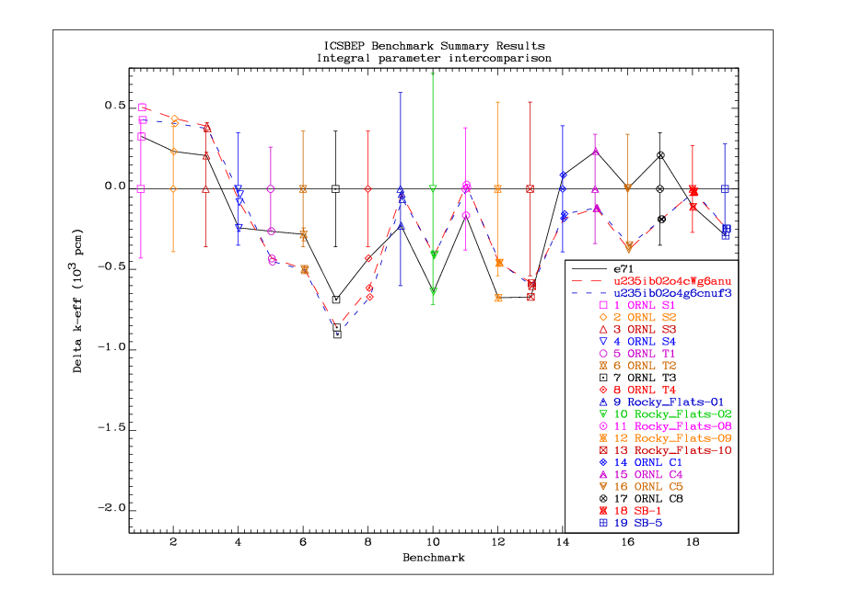

Slide 17
Surprises…
Out of about 200 benchmarks…
Comet-UH3
strong positive swing in reactivity (~800 pcm)
big shift already with ENDF/B-VII.1 data between cases 1/4 (DU+DU/Fe) and 6/7 (DU inner only)
ZPR-9/34 U/Fe-stainless steel reflected
strong positive swing in reactivity with new ²³⁵U data
high sensitivity to capture in the 10 keV region
BW-XI 1-11 borated water assemblies
strong negative swing (~500 pcm)
LCT-042 – negative swing of ~300 pcm (case 2 contains B)
IPEN-MB – negative swing of ~200 pcm (contains B in BP)

Slide 18
List of benchmarks with surprises
1 HEU-COMP-INTER-003 hci003-1 COMET-UH3-1
2 HEU-COMP-INTER-003 hci003-4 COMET-UH3-4
3 HEU-COMP-INTER-003 hci003-6 COMET-UH3-6
4 HEU-COMP-INTER-003 hci003-7 COMET-UH3-7
5 HEU-MET-INTER-001 hmi001 ZPR-9/34
6 LEU-COMP-THERM-008 lct008-01 BW-XI-1
7 LEU-COMP-THERM-008 lct008-02 BW-XI-2
8 LEU-COMP-THERM-008 lct008-05 BW-XI-5
9 LEU-COMP-THERM-008 lct008-07 BW-XI-7
10 LEU-COMP-THERM-008 lct008-08 BW-XI-8
11 LEU-COMP-THERM-008 lct008-11 BW-XI-11
12 LEU-COMP-THERM-042\lct042-1 lct042-1
13 LEU-COMP-THERM-042\lct042-2 lct042-2
14 LEU-COMP-THERM-043\lct043-2 IPEN/MB-01

Slide 19
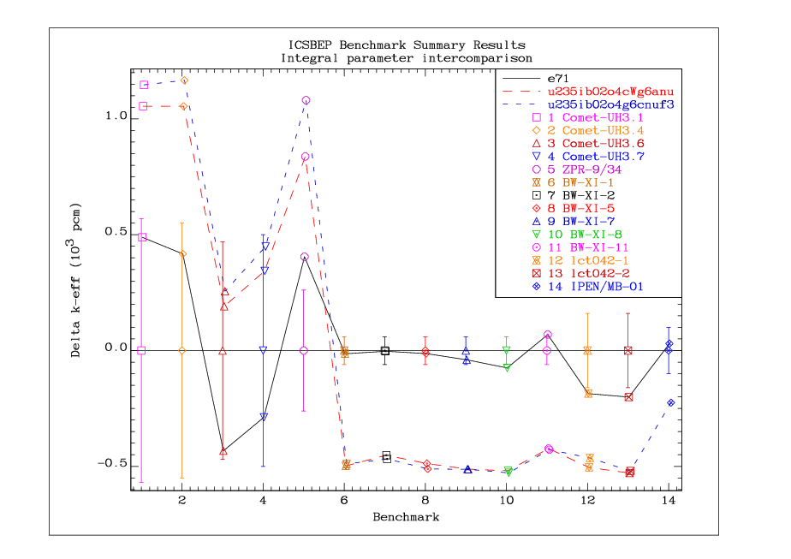

Slide 20
Other materials (²³⁸U, ¹⁶O)
There exist compensating effects due to other materials
²³⁸U and ¹⁶O were studied on fast benchmarks
Jemima benchmarks show significant improvements

Slide 21
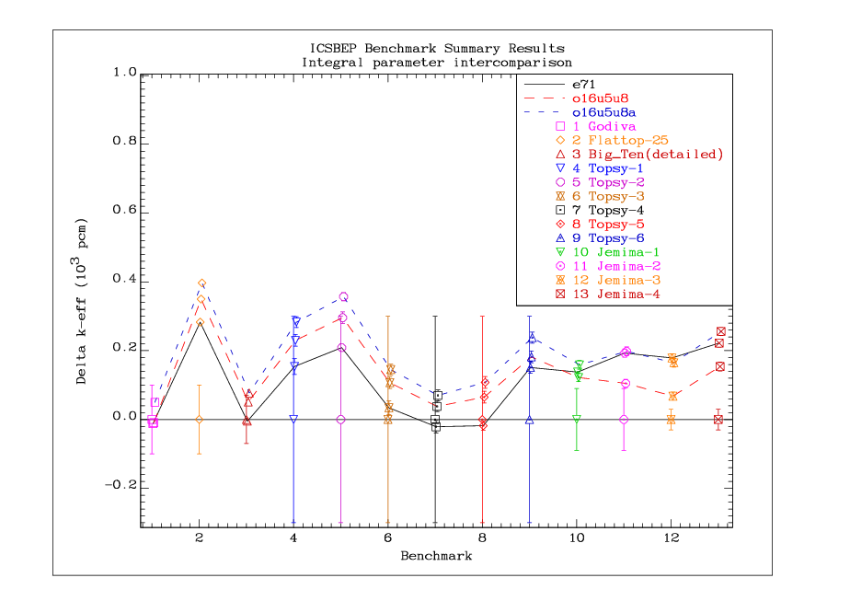

Slide 22
Conclusions
Effects that compensate the lower E_{av} of PFNS in ²³⁵U were investigated
Two variants of a new evaluation were tested
Both evaluations show performance comparable to ENDF/B-VII.1
“Surprises” could be attributed to energy regions or reactions that were less well evaluated, or to other materials in the system (to be checked…)
The conclusions are applicable to other actinides, since lowering of E_{av} is expected in all.

